Slide 1
Game Event Registration
This Website can be used to showcase an event and the games that may be played. This website will also be able to record usernames and contact information for event attendees.

Slide 2



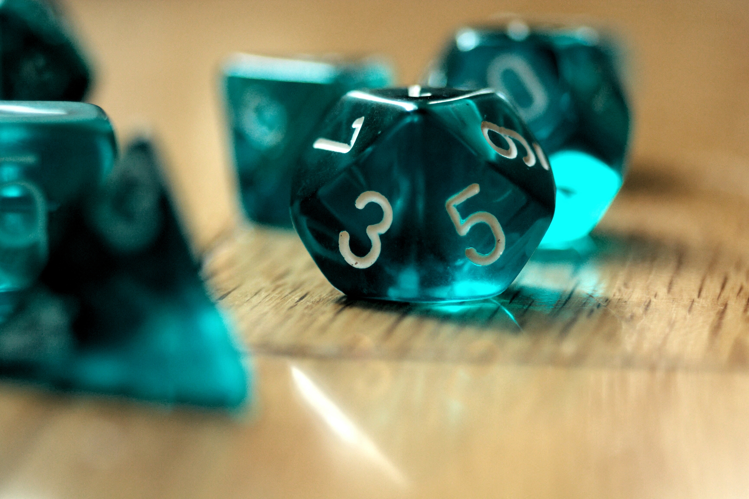
Home Screen
.gif of game footage or character A battling character B
.gif of game footage or character B battling character A
Navigation
Home Screen
Game 1
….
Game XX (however many will be planned)
Registration
Blurb generating interest, laying out the time and date of event.
All text and pictures are placeholders and may be changed.

Slide 3

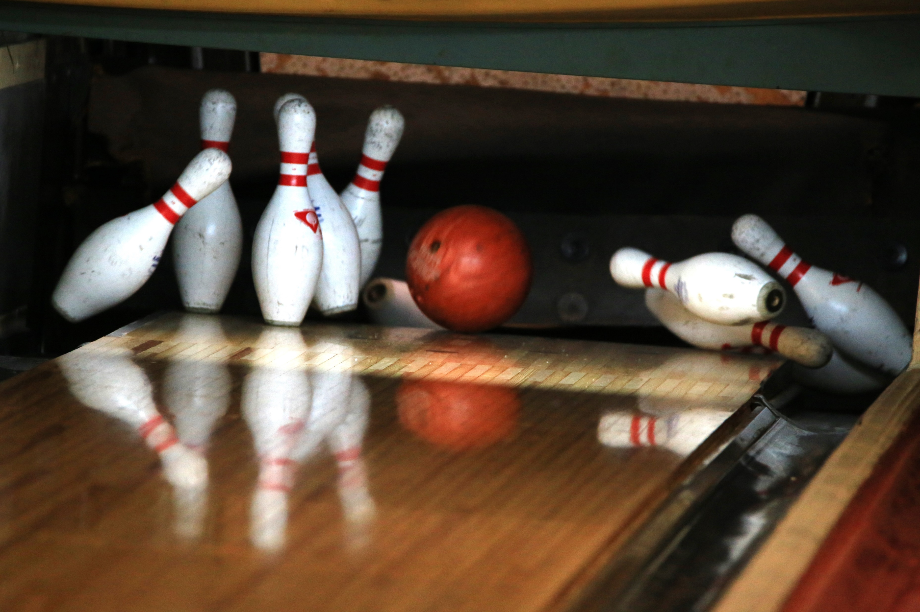
Game 1
.gif of game footage or character A battling character B
.gif of game footage or character B battling character A
Navigation
Home Screen
Game 1
….
Game XX (however many will be planned)
Registration
Blurb discussing game 1.
All text and pictures are placeholders and may be changed.

Slide 4

Game 2
.gif of game footage or character A battling character B
.gif of game footage or character B battling character A
Navigation
Home Screen
Game 1
….
Game XX (however many will be planned)
Registration
Blurb discussing game 2.
All text and pictures are placeholders and may be changed.

Slide 5

Game 3
.gif of game footage or character A battling character B
.gif of game footage or character B battling character A
Navigation
Home Screen
Game 1
….
Game XX (however many will be planned)
Registration
Blurb discussing game 3.
All text and pictures are placeholders and may be changed.

Slide 6
Registration
Navigation
Home Screen
Game 1
….
Game XX (however many will be planned)
Registration
Button
Button
Name | Alias | Contact information
This Form will list participants who have signed up.
General idea is to have it operate where you enter your information: name, alias, and a contact method, and then click a button to add your information to the list.
Perhaps the contact information may be concealed in some way, Uncertain on that idea.

